Slide 1


+
1401102-­‐3
Computer Programming
First Term: 2016/17
LecturerLecturer: Dr. Hatim Alsuwat
All Lecture notes represent a slightly edited version from lecture notes written by Dr. Abdulbaset Gaddah and Malak Aljabri

Slide 2








+
2
Outline
Common Escape Sequences
Naming Constants
Variable Scope
Data Type Conversion
Java Literals
Arithmetic Operators and Expressions
Precedence and Associativity
The String Type

Slide 3
+
Common Escape Sequences
3
Description Backspace Horizontal tab | Character \b \t | Ascii 8 9 | Unicode \u0008 \u0009
NUL character | \0 | 0 | \u0000
Linefeed – new line | \n | 10 | \u000A
Form Feed – new page | \f | 12 | \u000C
Carriage return | \r | 13 | \u000D
Double quote | \" | 34 | \u0022
Single quote | \' | 39 | \u0027
Backslash | \\ | 92 | \u005C

Slide 4
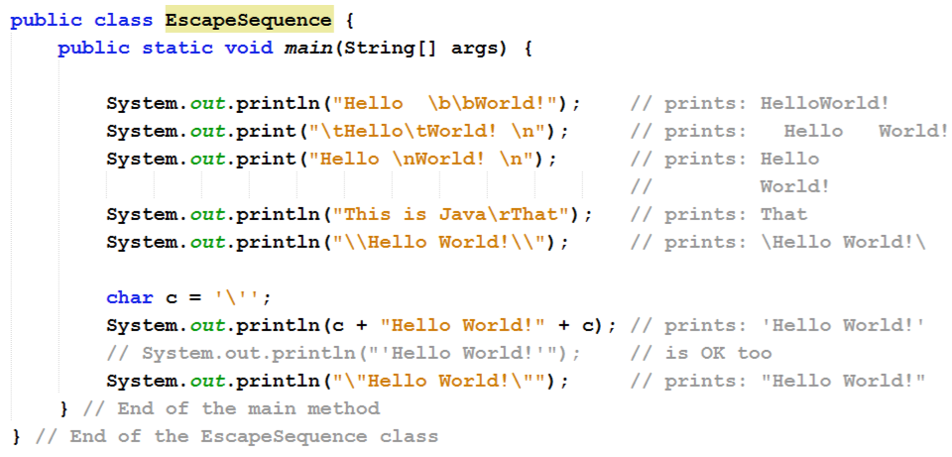
+
Escape Sequence Characters – Example
4

Slide 5
+
Naming Constants
5
A constant is like a variable except that it holds the same value during its entire lifetime
If a constant is used in multiple places, its value need only be updated in one place
In Java, the final modifier is used to declare a constant
final double PI = 3.14159;
The compiler will issue an error if the value of a constant is changed
Naming convention: UPPERCASE letters and an _

Slide 6
+ Computing the Area of a Circle
6
Java program starts
public class ComputeCircleArea {
from the main
method
/** The main method */
public static void main(String[] args) {
// Declare PI, radius, and area to be double variables
final double PI = 3.14159; double radius;
double area;
// Assign 20 to the radius variable
radius = 20;
// Compute the expression and then assign the result in the area variable
area = radius * radius * PI;
// Display the results
System.out.println("The area for the circle of radius "
+ radius + " is " + area);
}
}

Slide 7
+ Computing the Area of a Circle (Cont’d)
7
public class ComputeCircleArea {
allocate memory for PI &
assign a value to it
/** The main method */
public static void main(String[] args) {
memory
PI
3.14159
// Declare PI, radius, and area to be double variables
final double PI = 3.14159;
double radius; double area;
// Assign 20 to the radius variable
radius = 20;
// Compute the expression and then assign the result in the area variable
area = radius * radius * PI;
// Display the results
System.out.println("The area for the circle of radius "
+ radius + " is " + area);
}
}

Slide 8
+ Computing the Area of a Circle (Cont’d)
8
public class ComputeCircleArea {
/** The main method */
public static void main(String[] args) {
memory
// Declare PI, radius, and area to be double variables
final double PI = 3.14159;
PI
radius
3.14159
double radius;
no value
double area;
// Assign 20 to the radius variable
radius = 20;
allocate memory for radius
// Compute the expression and then assign the result in the area variable
area = radius * radius * PI;
// Display the results
System.out.println("The area for the circle of radius "
+ radius + " is " + area);
}
}

Slide 9
+ Computing the Area of a Circle (Cont’d)
9
public class ComputeCircleArea {
/** The main method */
public static void main(String[] args) {
memory
PI
radius area
3.14159
// Declare PI, radius, and area to be double variables
final double PI = 3.14159; double radius;
no value
no value
double area;
// Assign 20 to the radius variable
radius = 20;
allocate memory for area
// Compute the expression and then assign the result in the area variable
area = radius * radius * PI;
// Display the results
System.out.println("The area for the circle of radius "
+ radius + " is " + area);
}
}

Slide 10
+ Computing the Area of a Circle (Cont’d)
10
public class ComputeCircleArea {
/** The main method */
public static void main(String[] args) {
assign 20
to radius
memory
PI
radius area
3.14159
// Declare PI, radius, and area to be double variables
final double PI = 3.14159; double radius;
double area;
20
no value
// Assign 20 to the radius variable
// Compute the expression and then assign the result in the area variable
area = radius * radius * PI;
// Display the results
System.out.println("The area for the circle of radius "
+ radius + " is " + area);
}
}
radius = 20;

Slide 11
+ Computing the Area of a Circle (Cont’d)
11
public class ComputeCircleArea {
/** The main method */
public static void main(String[] args) {
memory
PI
radius area
3.14159
// Declare PI, radius, and area to be double variables
final double PI = 3.14159; double radius;
double area;
20
1256.636
// Assign 20 to the radius variable
radius = 20;
compute area and assign it to variable area
// Compute the expression and then assign the result in the area variable
// Display the results
System.out.println("The area for the circle of radius "
+ radius + " is " + area);
}
}
area = radius * radius * PI;

Slide 12

+ Computing the Area of a Circle (Cont’d)
12
public class ComputeCircleArea {
/** The main method */
public static void main(String[] args) {
memory
PI
radius area
3.14159
// Declare PI, radius, and area to be double variables
final double PI = 3.14159; double radius;
double area;
20
1256.636
// Assign 20 to the radius variable
radius = 20;
// Compute the expression and then assign the result in the area variable
area = radius * radius * PI;
// Display the results
print a message to the console
System.out.println("The area for the circle of radi
+ radius + " is " + area);
us "
}
}

Slide 13
+
Variable Scope
In a class definition, there are three kinds of variables:
Member variables in a class—known as fields
Variables in a method or block of code—known as local variables
Variables in method declarations—known as parameters
13
public class VariableScope { public int var1, var2;
// fields – visible in all methods
public void method1( int int total;
total = var1 + var2 *
}
par1 ){
par1;
// parameter – visible in method1
// local variable – visible in method1
public int method2( int par1 ){ for(int x = 0; x < 5; ++x){
System.out.println( x );
}
return par1 * var1 * var2;
}
// parameter – visible in method2
// local variable – visible in for
}
// Variable scope refers to the accessibility of a variable

Slide 14
+ Class-Level Scope (Member Variables)
14
Variables declared in a class (outside of any methods) are referred to as class-level variables. These variables are accessible from anywhere in the class (any method in ClassScope can access var1 directly)
! Note: you may define your class-level variables (fields) anywhere in the class as long as they are outside any methods, but inside the class
If a method declares a local variable with the same name as a class-level variable, the former will 'shadow' the latter. To access the class-level variable from inside the method body, use the this keyword
public class ClassScope {
public public
int
var1 = 2;
int
void method1(){
// A class-level variable (field)
var1 = 10;
// A local variable
System.out.println( var1 * this.var1 );
}
}

Slide 15
+
Method Scope (Local Variable)
Variables declared in a method or a constructor body (not in the header) are referred to as local variables
The scope and lifetime are limited to the method/constructor itself
The variables var1 and var2 cannot be accessed from another method
When the method ends, these variables cannot be accessed any longer
public class MethodScope {
public static void main (String[] args){
15
int
var1 = 10;
// A local variable
System.out.println( var1 ); System.out.println( var2 );
Scope of var1 and var2
// compilation
error!
int
var2 = 20;
// A local
variable
...
}
}

Slide 16
+
Method Scope (Parameters)
Here is another example of method scope variable, except this time the variable is declared in the method or constructor header (not in the body), which is refereed to as a parameter
The scope and lifetime of these variables is the method or constructor in which they are defined. As the method finishes execution, these variables are destroyed
public class MethodScope {
16
/* A parameter of type integer */
public void computeCircleArea (
int radius
){
double area = radius * radius
* PI;
…
…
}
}

Slide 17
+
Block Scope (Local Variable)
17
! Any variables defined inside of a block, such as a while, if or for block, are LOCAL TO THAT BLOCK. This means that once you exit the block body, the variables can no longer be accessed
public class BlockScope {
public static void main(String args[]){
int
n1 = 10;
// Visible in main method
if (n1 == 10) {
// Starts a new scope
// Visible only to this block
int n2 = 20;
// n1
System.out.println(
}
n2 = 100; // error!
and n2 both visible here
"n1= " + n1 + " n2= "
+ n2 );
as n2 is not visible here
// n1 is still visible here
System.out.println("n1 is " + n1);
}
}

Slide 18
+
Data Type Conversion
Changing a primitive value from one data type to another is known as data type conversion
Data type conversion are either widening or narrowing, it depends on the data capacities of the data types involved
Widening – a value of narrower data type is converted to a value of a broader data type. This is done implicitly by the JVM and also known as implicit casting (or automatic type conversion). A widening primitive conversion does not lose information about the overall magnitude of a numeric value.
Narrowing – a value of broader data type is converted to a value of a narrower data type, which can result in losing information. It requires explicit casting (the programmer tells the JVM the type to cast)
In Java, data type conversions can occur in three ways:
o assignment conversion, promotion conversion, and casting
18

Slide 19
+
Assignment Conversion
Assignment conversion occurs when a value of one type is assigned to a variable of another type
E.g., the following assignment converts the value in x to a double and assigns it to the variable y
Note that the value and type of x did not change
19
int x = 10; double y = x;
// widening conversion (implicit casting)
System.out.println("y= " + y + " x= " + x); // y= 10.0 x= 10
! Generally, a value of any type in the following list can be assigned to a variable of any type that appears to the right of it
byte → short → int → long → float → double char
! The type boolean is not assignment-compatible with any other type
! Because every character corresponds to a number in the Unicode encoding, the char type can be converted to/from any integer or floating point types.
byte to short, int, long, float, or double
short to int, long, float, or double
char to int, long, float, or double
int to long, float, or double
long to float or double
float to double

Slide 20
+
Promotion Conversion
20
" Promotion conversion happens automatically when performing a binary operation involving two operands of different types
int i = 4;
float f = 5.5f;
float result = f * i;
System.out.println("f * I = “ + result);
byte → short → int → long → float → double
char
// i converted to float (widening)
// f * i = 22.0
Type | Size | Valid Promotion
byte | 1 byte | double,float,long,int,short
short | 2 bytes | double,float,long,int
char | 2 bytes | double,float,long,int
int | 4 bytes | double,float,long
long | 8 bytes | Double, float
float | 4 bytes | Double
double | 8 bytes | -

Slide 21
+
Casting
21
Narrowing conversion is not always safe!
! It is reasonable to convert the integer value 13 to a byte, for example, but it is not reasonable to convert 1300 to byte since byte can only holds numbers between -128 and 127 .
Explicit casting is required when we perform a narrowing conversion
! A value of broader (higher size) type like double can be converted to a value of a narrower (lower size) type like int with explicit casting
To cast, the desired type is placed inside parentheses immediately in front of the variable to be cast
double d = 4.5;
long l = 12345678965L;
int b = (int)d;
int a = (int)l;
System.out.println(b);
// prints 4
System.out.println(a);
// prints -539222923
The type and value of the variable to be cast (d, l) does not change
If n and m are two integers, but we want a floating point result when dividing them, at least one of the two (n or m) must be type cast
float x = n / (float)m; OR
float x = (float)n / m;

Slide 22
Java Literals
+
22
" Literal – an item in Java which has one specific, fixed value that appears directly in the program. E.g., 4, 4.0, 'a', true, and "hello" are literals in the following statements:
int i = 4; double d = 4.0; char c = 'a';
boolean b = true; String s = "hello";
// Integer literal
// Float-point literal
// Character literal
// Boolean literal
// String literal
(2 > 3) ? true : false;
"This is a string literal".substring( 3 );
System.out.println("A string literal:
" +32.96f );

Slide 23
Java Literals (Cont’d)
+
23
Integer literals:
As positive or negative decimal numbers, such as 19, 51, -24
As octal numbers, using a leading 0 (zero) digit and one or more additional octal digits (0 – 7), such as 077, 024
As hexadecimal numbers, using 0x (or 0X) followed by one or more hexadecimal digits (0 – 9, a – f or A – F), such as 0xAFC, 0X7f7a
As binary numbers (starts in Java 7), using 0b (or 0B) followed by one or more binary digits (0 or 1), such as 0b0101
You may insert underscores between digits for clarity (starts in Java 7). It is used to separate groups of digits in numeric literals, which can improve the readability of your code. Examples: credit card numbers and phone numbers.
int i = 19; int o = 023; int h = 0x13;
int b = 0b10011; int u = 123_456_7;
byte b short s
= 10; // default int
= -24; // default int
l = 51; // default int
y =
z
long long long
12345678968l; // long
= 0b1010L;
// long

Slide 24
Java Literals (Cont’d)
+
24
Floating-point literals:
As positive or negative decimal fractions or exponential notation
An optional leading + or - sign, such as -1.2, +0.5, -2f, +3F
An optional exponent of the form 2.3254E+2, 123.21e-2
double f1 = 1.0e-2d, f2 = 1.0e2d;
System.out.println("\n f1 = "+ f1 );// prints:f1 = 0.01
System.out.println("\n f2 = "+ f2 );// prints:f2 = 100.0
An optional floating point suffix: f or F indicating a single precision (4 bytes) floating point number, or d or D indicating double precision (8 bytes) floating point number (the default)
double | floatPoint1 | = | 5.0; | // | default double
double | floatPoint2 | = | 5d; | // | denote double
double | floatPoint3 | = | -0.5; | // | default double
float double | floatPoint4 floatPoint5 | = = | 10f; 3.14159E0; | // // | denote float denote exponent | (double)
float | floatPoint6 | = | 2.718_281F; | // | denote float
double | floatPoint7 | = | 1.0e-6D; | // | denote exponent | (double)

Slide 25
Java Literals (Cont’d)
+
25
Boolean literals:
There are only two boolean literals, true or false
They must be spelled with all lowercase letters
boolean bVar1 = true; boolean bVar2 = false;
// “True" illegal
// FALSE illegal
Character literals:
May contain any Unicode characters, such as a, 1, $, π, β, B
Are expressed in Java as 'a', '1', '$', 'π', 'β', 'B'
Are 16-bit Unicode characters, ranging from 0 to 65535
May be safely promoted to larger integer types like int and long
char ascChar = 'a';
char uniChar = '\u0061';
// ASCII
\u + 4 hexadecimal digits
// Unicode

Slide 26
Java Literals (Cont’d)
+
26
! String literals:
! Consist of the double quote character " zero or more characters, followed by a terminating double quote character ", such as "Hello World!", "March 23, 2014", "1200", "4", ""
String stringVar1 = "Hello World!";
String stringVar2 = null;
// A special Java literal, which means it does not refer to any object
Within string and character literals, the backslash (\) character can be used to escape special characters, such as
String text1 = "This is line 1\n line 2\n and line 3\n"; String text2 = " \"This is a quoted text\" ";
A string literal cannot be broken across two lines in a program
String s1 = "This is line 1
This is line 2";

Slide 27
Arithmetic Operators and Expressions
+
27
! As in most languages, arithmetic expressions can be formed in Java using arithmetic operators, numerical literals, and variables
! Java has five arithmetic operators
Operation | Operator | Algebraic Expression | Java Expression
Addition | + | f + 7 | f + 7
Subtraction | - | p – c | p – c
Multiplication | * | bm | b * m
Division | / | x / y or x ÷ y | x /y
Reminder | % | r mod s | r % s
3 + 4x ₋ 10( y − 5)(a + b + c) ₊ ₉₍ 4 ₊ 9 + x ₎
5 x x y
(3+4*x)/5 – 10*(y-5)*(a+b+c)/x + 9*(4/x + (9+x)/y)

Slide 28
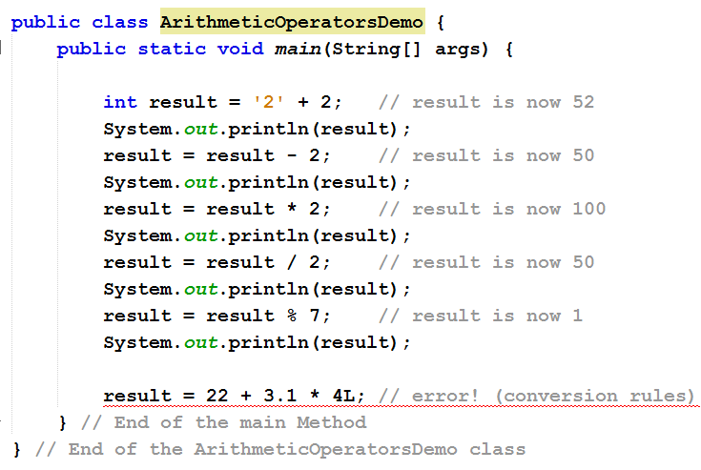
Arithmetic Operators and Expressions – Example
+
28

Slide 29
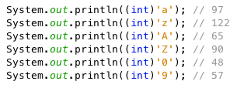
+
29

Slide 30
Precedence of Arithmetic Operators
+
30
Operator | Operation | Precedence (order of evaluation)
* | Multiplication | Evaluated first. If there are several operators of this type, they're evaluated from left to right.
/ | Division
% | Remainder
+ | Addition | Evaluated next. If there are several operators of this type, they're evaluated from left to right.
– | Subtraction
= | Assignment | Evaluated last.
3 + 4 * 4 + 5 * (4 + 3) - 1
3 + 4 * 4 + 5 * 7 – 1
(1) inside parentheses first
3 + 16 + 5 * 7 – 1
(2) multiplication
(3) multiplication
How to evaluate an expression?
3 + 16 + 35 – 1
19 + 35 – 1
(4) addition
54 - 1
(5) addition
(6) subtraction

Slide 31
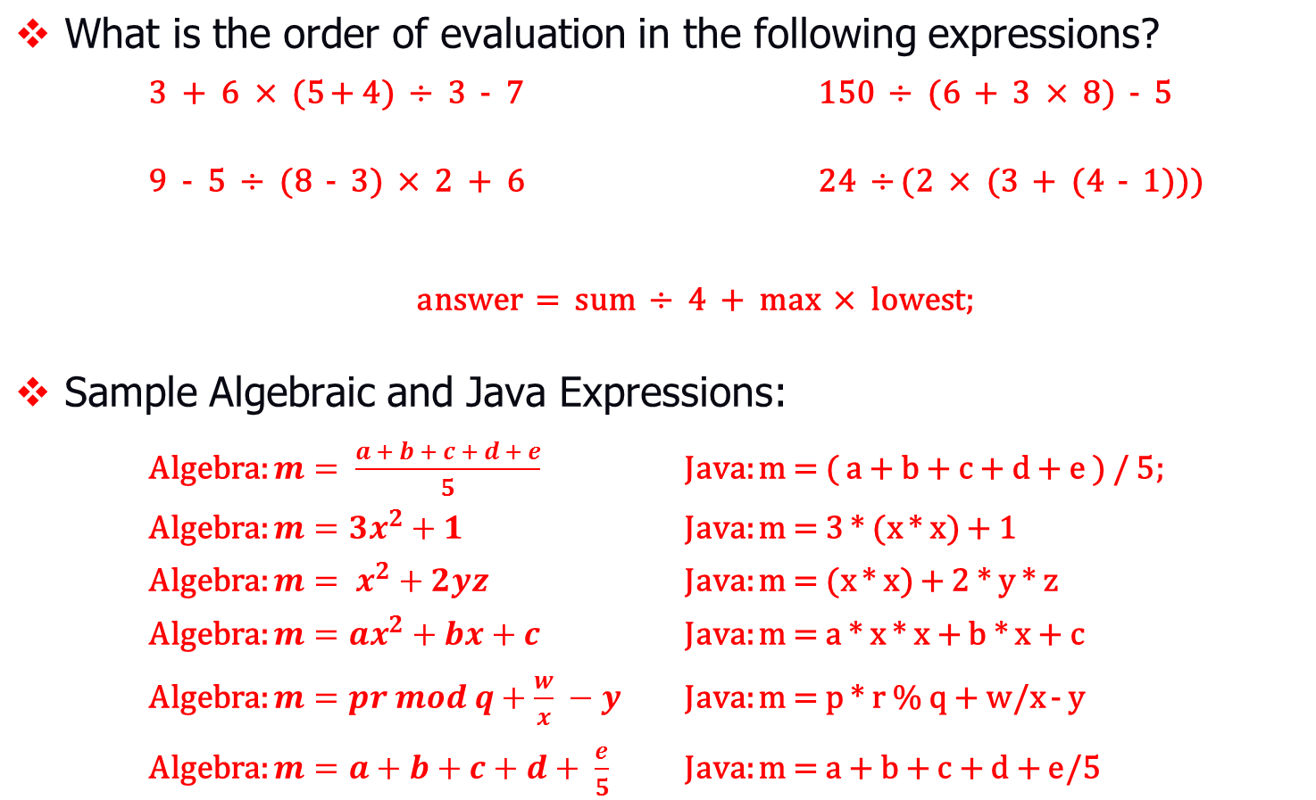
+ Precedence of Arithmetic Operators - Examples
31
!
4
2
1
3
5
3
2
1
4
4
2
1
3
5
4
3
2
1
4
1
3
2

Slide 32

Shorthand Assignment Operators
+
32
Very often the current value of a variable is used, modified and reassigned back to the same variable, for example:
i = i + 8;
! The value 8 is added to the current contents of the variable i and the resulting value becomes the new contents of i
Java allows you to combine assignment and addition operators using a shorthand operator, for example:
i += 8;
i + = 8; // Error! spaces not allowed
The right-hand side can be another variable, a constant, or a more complicated expression. It is evaluated first, and then the result is combined with the original variable
x *= (y + z) % 2; equivalent to
x = x * ((y + z) % 2);
Required

Slide 33
Shorthand Assignment Operators (Cont’d)
+
33
Operator | Example | Equivalent To
+= | x += 2; | x = x + 2;
-= | x -= y; | x = x – y;
*= | x *= 2.5; | x = x * 2.5;
/= | x /= y; | x = x / y;
%= | x %= 10; | x = x % 10;
NOTE: The shorthand operators can also be used with char variables
char ch = 'a';
System.out.println(ch += 2); // prints c
Caution: consider the following statements:
byte b = 1;
b = b + 1; b += 1;
// error: conversion rules
// correct: equivalent to b = (byte)(b + 1);

Slide 34
Unary Operators
+
34
! The unary operators require only one operand; they perform various operations such as incrementing or decrementing a value by one, negating an expression, or inverting the value of a boolean
o These operators are +, -, ++, --, and !
Operator | Symbol | Operation | Java Expression
Unary plus operator | + | indicates positive value; by default numbers are positive | number = +1;
Unary minus operator | - | negates an expression | x = -number;
Increment operator | ++ | increments a value by 1 | number = ++x;
Decrement operator | -- | decrements a value by 1 | number = --x;
Logical complement operator | ! | inverts the value of a boolean | b = !(false);

Slide 35
⁺ The Shorthand Increment & Decrement Operators
35
There are two more shorthand operators for incrementing and decrementing the value of a variable by 1
The increment operator (++): increases the value of a variable by 1
If int n = 2, then n++ or ++n will change the value of n to 3
The decrement operator (--): decreases the value of a variable by 1
If int n = 4, then n-- or --n will change the value of n to 3
Both operators can be applied before or after the operand
o prefix: such as ++n; or --n; postfix: such as n++; or n--;
int i = 10;
int newNum = 10 * i++;
Same effect as
int newNum = 10 * i; i = i + 1;
int i = 10;
int newNum = 10 * ++i;
Same effect as
i = i + 1;
int newNum = 10 * i;

Slide 36
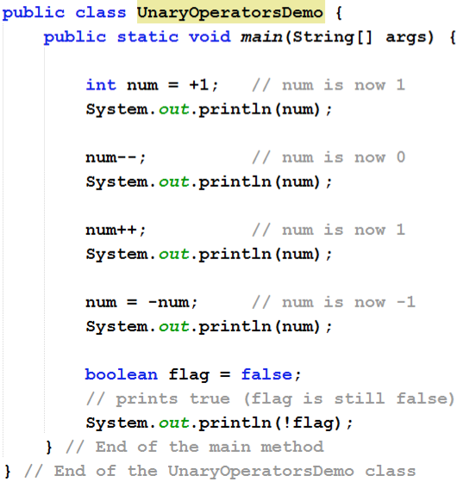
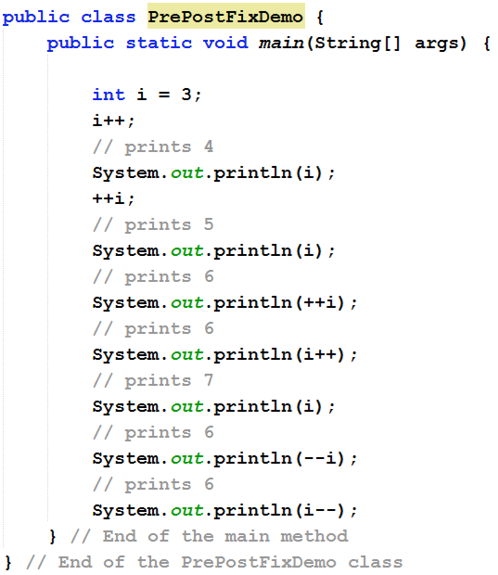
Unary Operators - Example
+
36

Slide 37

+ Precedence of Unary Operators
Operator | Operation
 |  | Precedence (order of evaluation)
postfix (increment) | n++ | Evaluated first. If there are several operators of this type, they're evaluated from right to left.
postfix (decrement) | n--
Unary plus | +n | Evaluated next. If there are several operators of this type, they're evaluated from right to left.
unary minus | -n
prefix (increment) | ++n
prefix (decrement) | --n
logical compliment | !
37
NOTE: The increment/decrement operators
char ch = 'a';
System.out.println( ++ch );
can be
used with
char variables
Caution: Avoid using the increment/decrement operators modify multiple variables or the same variable multiple times
in expressions
that
double z = x-- + ++y; or
int k = ++i + i;

Slide 39
Precedence and Associativity
+
38
What is the execution order of the operators?
Arithmetically, the expression in the parentheses is evaluated first.
Parentheses can be nested, in which case the expression in the inner parentheses is executed first
When evaluating an expression without parentheses, the operators are applied according to the precedence and associativity rules
When two operators share an operand the operator with the higher precedence goes first, e.g., 1 + 2 * 3 is treated as 1 + (2 * 3)
When two operators have the same precedence, the expression is evaluated according to associativity rules, e.g., x = y = z = 17 is treated as x = (y = (z = 17))

Slide 40
Precedence and Associativity (Cont’d)
+
39
The table below shows all Java operators, which you have learned so far, from highest to lowest precedence along with their associativity
Highest
Precedence | Associativity
( ) parenthesis for explicit grouping | Left – Right
++, -- ( postfix as in x++ and x-- ) | Right – Left
The unary operators: -, +, ++, -- ( prefix as in + +x and --x ), and ! | Right – Left
Type cast (type) | Right – Left
The binary operators: *, /, % | Left – Right
The binary operators: +, - | Left – Right
The assignment operators: = += -= *= /= %= | Right – Left
Lowest

Slide 41
Operator Associativity
+
40
Associativity: when two operators have the same precedence, the associativity of the operators determines the evaluation order
Unary operators of equal precedence are grouped right-to-left
+-+rate is evaluated as +(-(+rate))
Binary operators of equal precedence are grouped left-to-right
base + rate - hours + days
is evaluated as
((base + rate) - hours) + days
! Assignment operators are grouped right-to-left
n1 = n2 = n3;
a = b += c = 5;
is evaluated as is evaluated as
n1 = (n2 = n3);
a = (b += (c = 5));

Slide 42
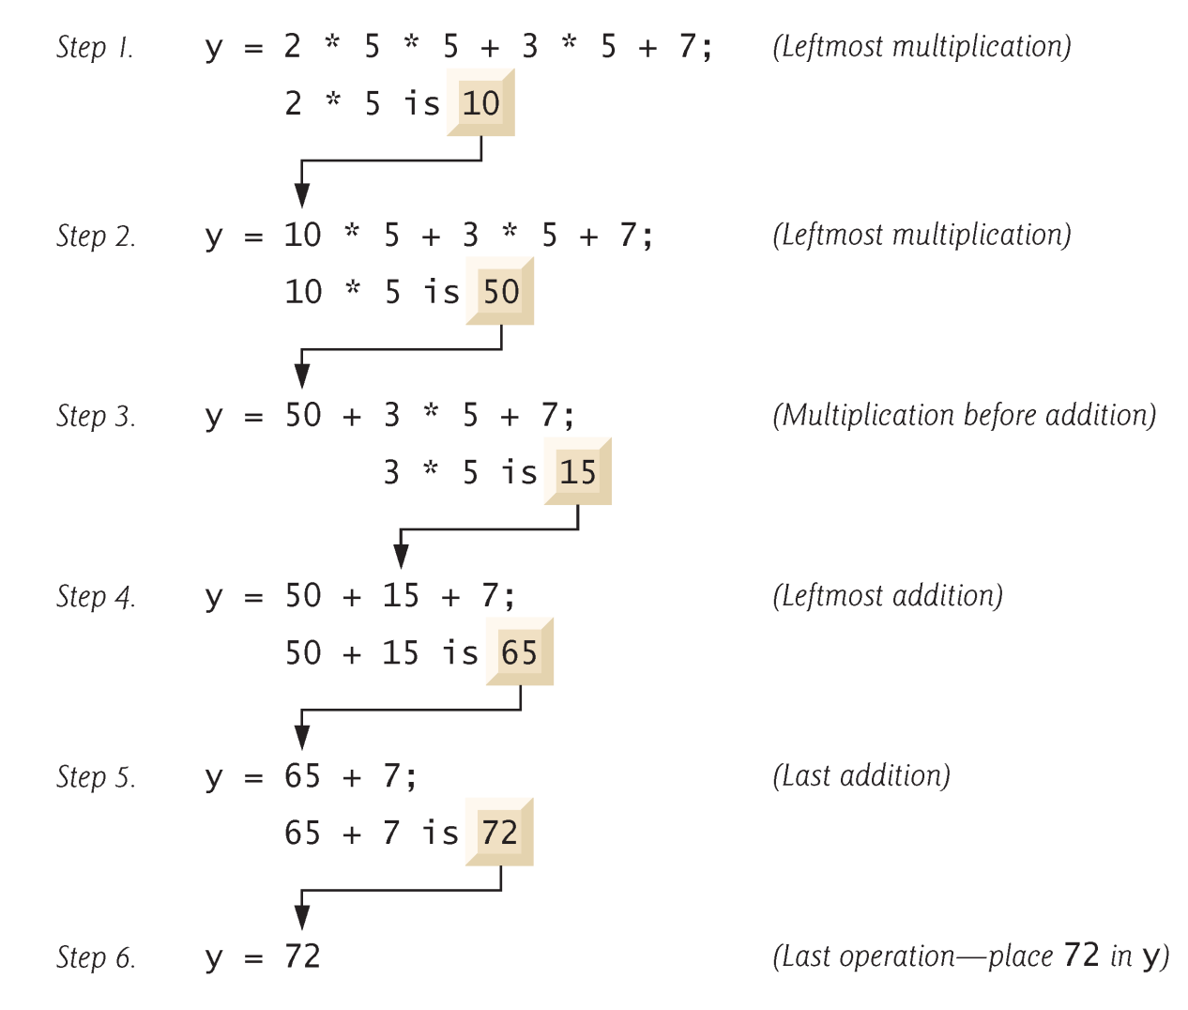
Precedence and Associativity – Example
+
41
" Applying the precedence and associativity rules, the expression
y = 2 * 5 * 5 + 3 * 5 + 7 is evaluated as follows:

Slide 43
The Integer and Floating-Point Division
+
42
" When one or both operands are a floating-point type, division results in a floating-point type
15.0/2 evaluates to 7.5 (double)15/2 evaluates to 7.5
When both operands are integer types, division results in an integer type. Any fractional part is discarded (not rounded)
15/2 evaluates to 7 14/3 evaluates to 4 8/12 evaluates to ?
Be careful to make at least one of the operands a floating-point type if the fractional portion is needed

Slide 44
The Reminder (%) Operator
+
43
" The reminder % operator is usually used with operands of type
int to recover the information lost after performing integer division
15/2 evaluates to 7 8/12 evaluates to ?
15%2 evaluates to 1 8%12 evaluates to ?
The % operator can be used to count by 2's, 3's, 4's, …
o To count by 2's, use n % 2, when the result is 0, n is even; when the result is 1, n is odd
Suppose today is Saturday and you want to meet your friends after 10 days. What day is in 10 days? You can find that day is Tuesday using the following expression:
Saturday is the
₇th
day in a week
A week has 7 days
(7 + 10) % 7
After 10 days
is 3 The
₃nd
day in a week is Tuesday

Slide 45
The String Type
+
44
The char type only represents one character 'A'. To represent a sequence of characters, use the data type called String
Java provides the String class (located at java.lang package) to create and manipulate strings
The most direct way to create an instance of String class is to write:
String str = "Welcom to Java";
str
Welcome to Java
Reference variable
On the right hand side a String object is created, representing the string
literal. Its object reference is assigned to the str variable
Creating an object is called instantiation
String object
! The String type is known as a reference type

Slide 46
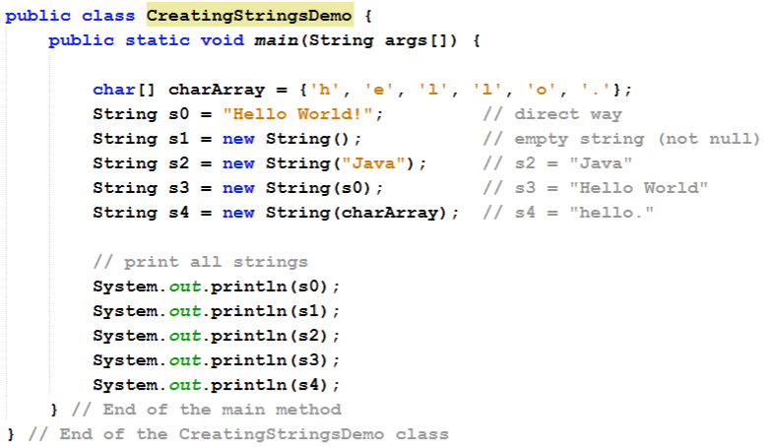
The Constructors of String Class
+
45
" String objects can also be created using the new keyword and a constructor. The String class has 13 constructors that allow you to provide the initial value of the string using different sources

Slide 47
String Concatenation
+
46
! Java strings can be concatenated (joined) using the + or += operators to create new strings
String str1 = "Java"; | // | Java
String str2 = "Hello " + str1; | // | Hello Java
str2 += ", World"; | // | Hello Java, World
! The String class also includes a method for concatenating strings:
String str3 = str1.concat(" fun");
// Java fun
String str4 = "I love ".concat(str1);
// I love Java
! When a String is combined with almost any other data type, it will be implicitly converted to string before the concatenation
"The | answer | is | " + | 4 | evaluates to | "The answer is 4"
"The | answer | is | " + | 4 + 2 | evaluates to | "The answer is 42"
"The | answer | is | " + | 2 + 4.0 * 2 | evaluates to | ?

Slide 48















Immutable String
+
47
String objects in Java are immutable, i.e., they cannot be modified once created. Whenever it looks as if a String object was modified actually a new String was created
The original memory containing "Hello Java" is unchanged and will be eventually collected by the
Garbage Collector as the memory space is no longer referenced by variable str2
Java
str1
Hello Java
X
str2
Hello Java, World
Heap
String constant pool

Slide 49
The == Operator
+
48
! Use of the == operator only tests whether two String object references refer to the same object (memory space). The == operator does not test whether the contents of the two Strings are equal
Example == operator |  |  |  |  | Output
String s1 = new String( | "Hello" ); |  |  |  | Hello
String s2 = new String( | "Hello" ); |  |  |  | Hello
String s3 = s1; |  |  |  |  | s3 has the refer of s1
System.out.println("s1 | == s2: " + (s1 | == | s2) | ); | s1 == s2: false
System.out.println("s1 | equals s2: " +
s1.equals(s2) ); |  |  |  |  | s1 equals s2: true
System.out.println("s1 | == s3: " + (s1 | == | s3) | ); | s1 == s3: true
System.out.println("s2 | == s3: " + (s2 | == | s3) | ); | s2 == s3: false
! Note: never use == to test equality of String contents

Slide 50
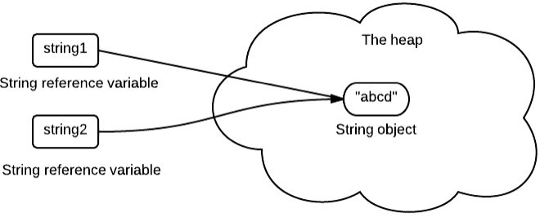
The new and = operators
+
49
! If new is not used to assign a value to a String object, then all other strings constructed similarly with the same literal value will refer to the same object in memory
Assigning a value to string object = | Output
String string1 = "abcd"; String string2 = "abcd"; boolean b1 = (string1 == string2); boolean b2 = string1.equals(string2); | true true
String constant pool

Slide 51
String Methods
+
50
The String class provides a number of useful methods, all of which can be called on any instance of the class
Several of these methods return information about the String and its characters, which can be used in an assignment or expression
String str = "Hello";
object
// creates a String
int len =
str.length();
// returns 5
// prints 5
System.out.println( System.out.println( String s =
len );
str.equals("C++
") ); // false
; //
str.concat(" Java " + 7)
Hello Java 7

Slide 52
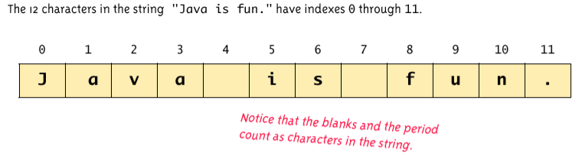
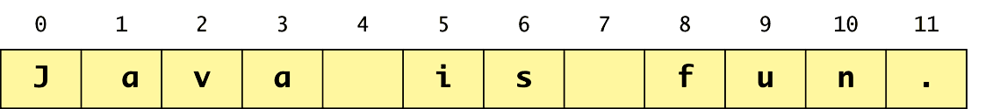
String Indexes
+
51
" Always count from zero when referring to the position or index of a character in a string
String str = "Java string
is fun.";
subStr = str.substring(5, 10);
System.out.println("sub string:
Output: is fu
character 10 is not included
" + subStr);

Slide 53
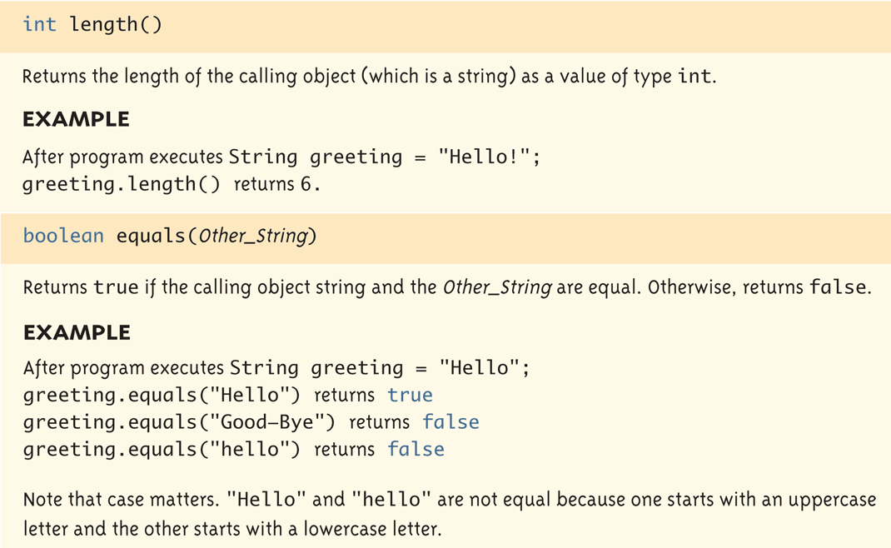
+ Some Methods in String Class (1/8)
52

Slide 54
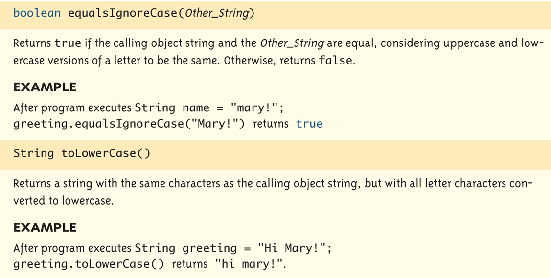
⁺ Some Methods in String Class (2/8)
53

Slide 55
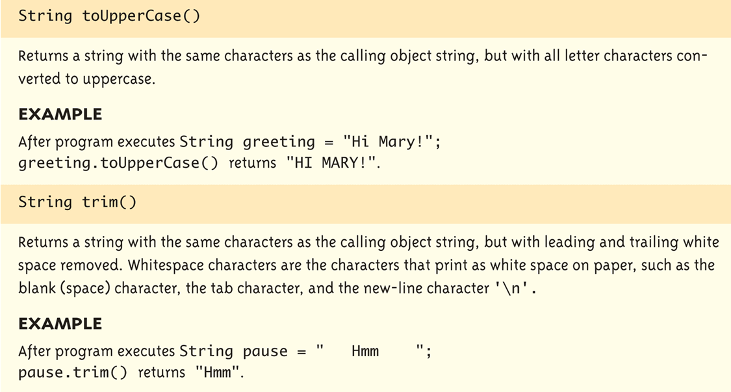
+ Some Methods in String Class (3/8)
54

Slide 56
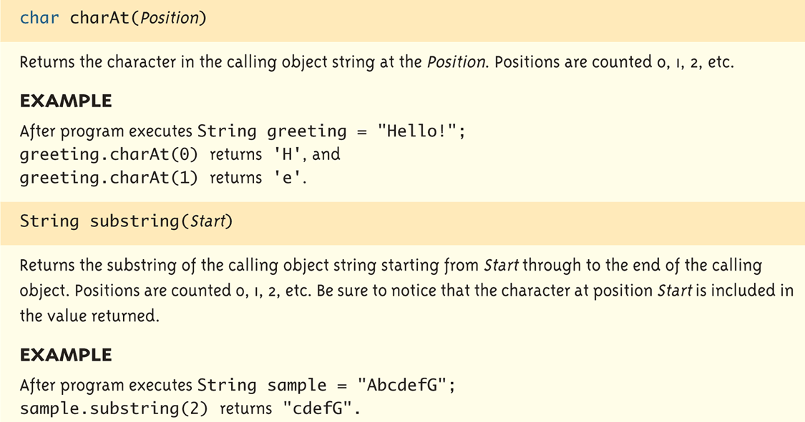
+ Some Methods in String Class (4/8)
55

Slide 57
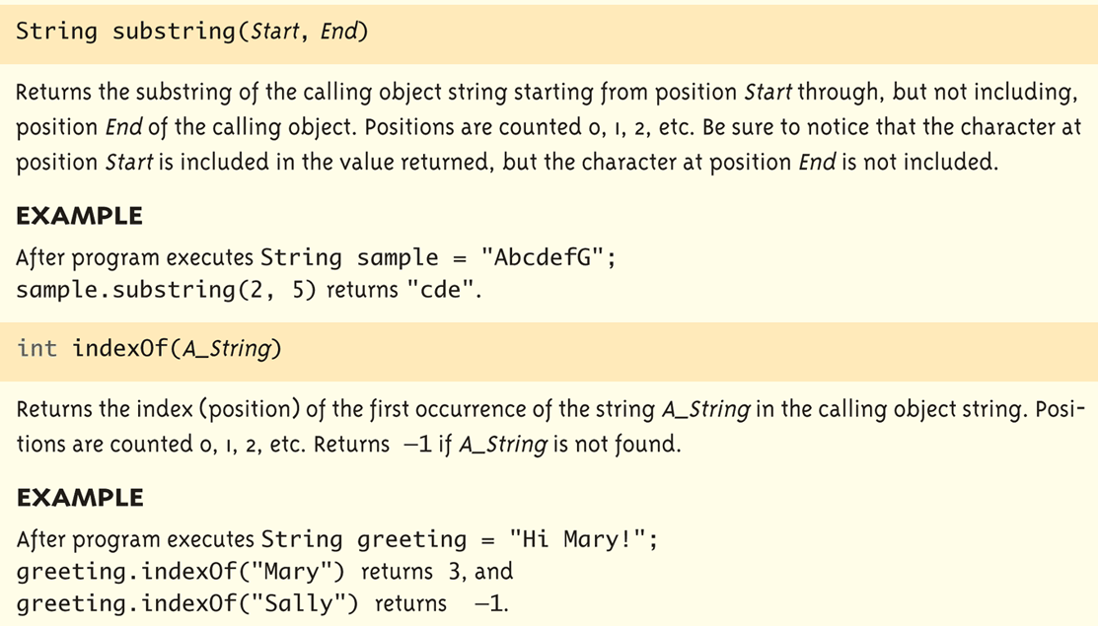
+ Some Methods in String Class (5/8)
56

Slide 58
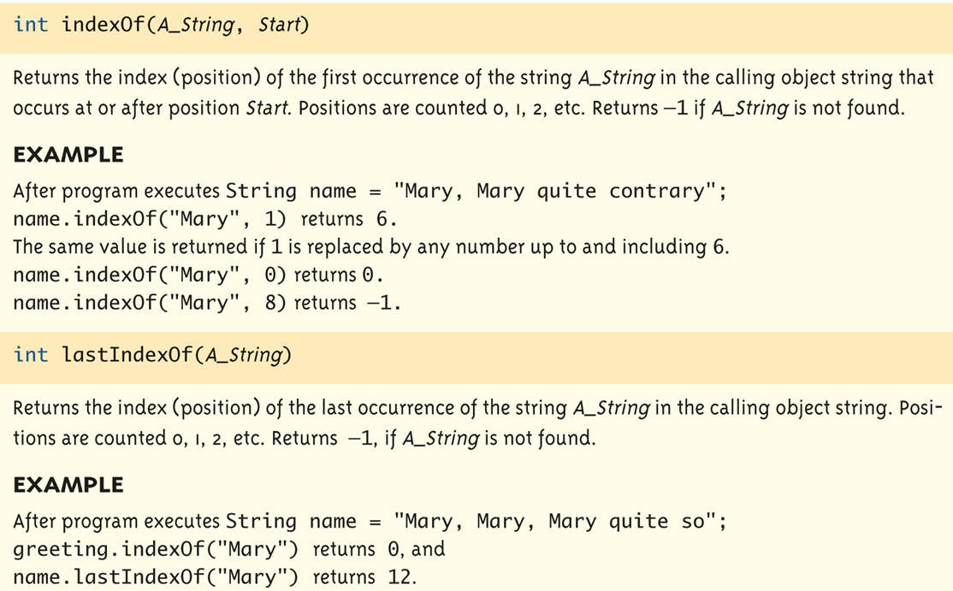
+ Some Methods in String Class (6/8)
57

Slide 59
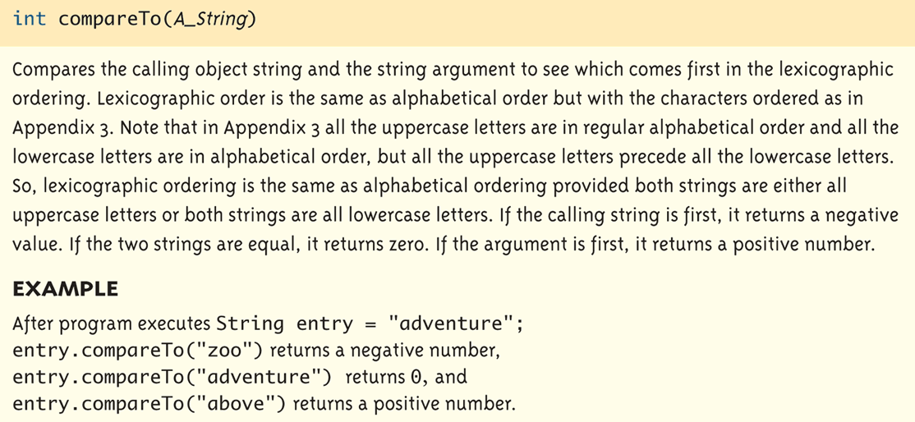
+ Some Methods in String Class (7/8)
58

Slide 60
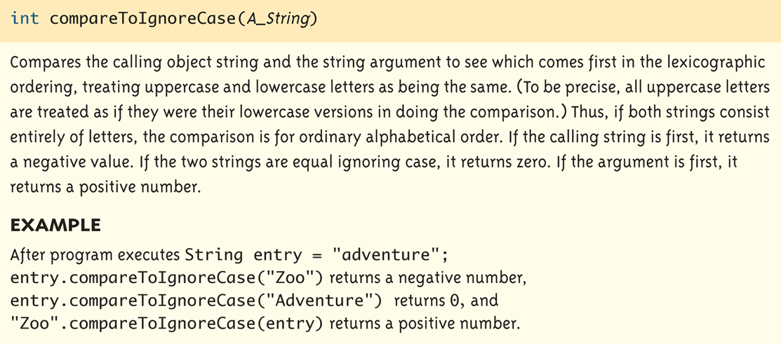
+ Some Methods in String Class (8/8)
59

Slide 61
+
60
Reference Book
! Java How to Program, 9/e

Slide 62

+
61
Any Questions??

